Slide 1
Introduction to SAD and SDLC
School of Computing and Engineering

Slide 2
Learning Objectives
Understand Systems Analysis and Design concepts;
Describe Systems Development Lifecycle (SDLC);
Learn System Analyst role and skills.

Slide 3
Lecture Plan
Introduction to the module 30 min
What is Systems analysis and design 10 min
Systems Development Lifecycle 10 min
Q&A 10 min
System Analyst role 10 min
Q&A 10 min
System Analyst skills 10
Class exercise 30 min

Slide 4
System
A system is a set of connected components that function together to achieve a common goal.
The components/subsystems of the system are interdependent (the function of one component effects the other one).
Component/subsystems interact to achieve system’s goal.
A system receives inputs which then transformed into outputs.
Information System (IS) is also viewed as a system.

Slide 5
What is systems analysis and design?

Slide 6
Answer:
In IS, it is a method used by companies ranging from IBM to PepsiCo to Sony to create and maintain information systems that perform basic business functions such as keeping track of customer names and addresses, processing order, and paying employees.
The main goal of systems analysis and design is to improve organisational systems, typically through applying software that can help employees accomplish key business tasks more easily and efficiently.
[2]

Slide 7

Systems Analysis and Design
Studies the existing system before formulating the requirements for the new system and deals with two initial questions:
What is the problem?
What is the best solution for this problem?

Slide 8
Systems Analysis and Design
Creates the model for the solution and deals with these question:
How should the data be presented?
How should the user interact with the system?
What is the best way to organise the programming system?

Slide 9
What is systems development life cycle?

Slide 10




Systems Development Life Cycle (SDLC)
The development of an IS system is accomplished according to a framework of activities and tasks known as systems development life cycle.
Implementation
Design

Slide 11
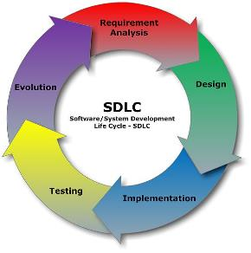
SDLC
The systems development life cycle (SDLC) is the process of determining how a system can support organisation needs, designing the system, building it, and delivering it to users.
[4]

Slide 12
SDLC
The SDLC is composed of four fundamental phases:
Planning
Analysis
Design
Implementation
Each of the phases is composed of steps, which rely on techniques that produce deliverables (specific documents that explain various elements of the system).

Slide 13
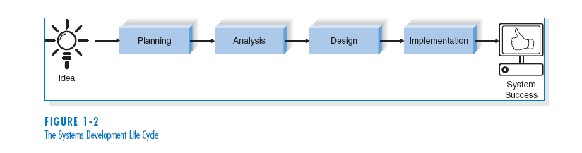
THE SYSTEMS DEVELOPMENT LIFE CYCLE (SDLC)
[4]

Slide 14
Phases Common to All SDLCs
Planning
why build the system?
Analysis
who, what, when, where will system be?
Design
how will system work?
Implementation
system delivery and maintenance
Notes:
Fundamental four-stage systems development life cycle

Slide 15
Planning
This phase is the fundamental process of understanding why an information system should be built, and determining how the project team will go about building it.
The planning phase has two steps:
During project initiation, the system’s business value to the organization is identified (How will it lower costs or increase revenues?).
Feasibility analysis.
During project management, the project manager creates a work plan, staffs the project, and puts techniques in place to help the project team control and direct the project through the entire SDLC.

Slide 16
Analysis
The analysis phase answers the questions of who will use the system, what the system will do, and where and when it will be used.
During this phase the project team investigates any current system(s), identifies improvement opportunities, and develops a concept for the new system.

Slide 17
The analysis phase has three steps:
1. Analysis strategy: This is developed to guide the projects team’s efforts. This includes a study of the current system and its problems, and envisioning ways to design a new system.
2. Requirements gathering: The analysis of this information leads to the development of a concept for a new system. This concept is used to build a set of analysis models.
3. System proposal: The proposal is presented to the project sponsor and other key individuals who decide whether the project should continue to move forward.

Slide 18
Design
The design phase decides how the system will operate, in terms of the hardware, software, and network infrastructure; the user interface, forms, and reports that will be used; and the specific programs, databases, and files that will be needed.

Slide 19
The design phase has four steps:
1. Design Strategy: This clarifies whether the system will be developed by the company or outside the company.
2. Architecture Design: This describes the hardware, software, and network infrastructure that will be used.
3. Database and File Specifications: These documents define what and where the data will be stored.
4. Program Design: Defines what programs need to be written and what they will do.

Slide 20
Implementation
During the implementation phase, the system is either developed or purchased (in the case of packaged software) and installed.
This phase is usually the longest and most expensive part of the process.

Slide 21
The implementation phase has three steps:
1. System Construction: The system is built and tested to make sure it performs as designed.
2. Installation: The old system is turned off and the new one is turned on.
3. Support Plan: Includes a post-implementation review as well as a systematic way for identifying changes needed for the system.

Slide 22
Identify the steps required for each phase :
Planning:
Analysis:
Design:
Implementation:

Slide 23

System Analyst
What is the role of System Analyst in IS development?
The key person in the SDLC is the systems analyst, who analyses the business situation, identifies the opportunities for improvements, and designs an IS to implement the improvements.

Slide 24

System Analyst
The primary goal is to create value for the organisation which for most companies means increasing profits.

Slide 25
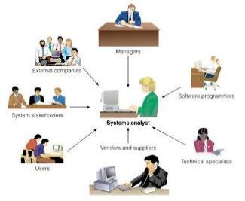
System Analyst
Must build systems to support the organisation’s goal, improve business processes, and integrate with other information systems to provide value.
The goal is to enable the organisation to perform work better so that it can earn greater profits.

Slide 26
Systems analyst
The systems analyst:
works closely with all project team members so that the team develops the right system in an effective way.
must understand how to apply technology in order to solve problems.
may serve as change agents who identify organisational improvement needed, design systems to implement those changes, and train and motivate others to use the systems.
[4]

Slide 27
Skills
New IS introduces change to the organisation and its people…
Leading a successful organisational change effort is one of the most difficult jobs…
Understanding what to change require a wide range of skills…

Slide 28
What type of skills do you require to be a good system analyst?

Slide 29
Systems analyst skills
Technical: to understand the organisation’s existing technical environment
Business: to understand how IT can be applied to business situations and delivers real business value
Analytical: analyst are problem solvers at the project and organisational level.
Interpersonal and Management: analyst need to communicate effectively with all stakeholders and be able to manage them as well as the project.
Ethical: must deal fairly and honestly and maintain confidence and trust with all people.

Slide 30
The Key Players
A stakeholder is any person who has an interest in an existing or new system. Stakeholders can be technical or non-technical workers
Stakeholders can be classified as:
System owners
System users
Systems analysts
System designers
System builders (programmers!)
IT vendors and consultants

Slide 31
System Owners
Main project sponsors
Responsible for funding the project to develop, operate and maintain the system
May select the project manager
Involved in allocating resources to and overseeing system development projects
Notes:
May have a direct role in systems development if project is small

Slide 32
System Users
People who use or are affected by the system
Internal users are those employed by the company
Clerical and service workers
Technical and professional staff
Supervisors, middle managers, and executive managers
Remote and mobile users (internal but disconnected)
External users refer to third parties such as customers or other organisations

Slide 33
System Analysts
Study the problems and needs of an organisation (or market!) to determine how computer-based systems can best accomplish improvements for the business (or best develop a new product)
Plays key role in systems development process
Efficient capture of data from its business source
The flow of that data to the computer
The processing and storage of that data by the computer
The flow of useful and timely information back to the business and its people

Slide 34
References
Dennis, A., and Wixom, B. H, “Systems Analysis and Design”, 5th Edition, John Wiley & Sons (2013), Chapter one.
Hoffer, V.G. “Essentials of Systems Analysis & Design”, 5th Edition, Pearson (2014)

